Slide 1
Car Price Prediction Using Decision Tree
By
Madhav Kamani

Slide 2
Table of contents
Car_Name : It contains the name of the vehicle, and since different clients bought the same model in various years, the names of the vehicles are repeated.
Year : This column contains the car's manufactured year.
Selling_Price : The owner wants to sell the car to others in the present year 2023 (in lakhs).
Present_Price : Ex-showroom price (in lakhs).
Kms_Driven : The kilometers, the car has travelled till now.
Fuel_Type : It means the cars has 3 fuel types. They are Diesel , Petrol and CNG.
Seller_Type : In seller type, the car is selling by the individual owner and Dealer.
Transmission : It indicates the car has two gear types i.e., Manual and Automatic.
Owner : It tells us how many owners the car has in previous.

Slide 3
Abstract/Summary
Car price prediction employs computer methods to guess how much a car might cost. It uses details like the car's age, how far it's been driven, and its features. Think of it like a smart guess based on past car sales.
By studying these details, the computer figures out patterns and gives a likely price range. This helps people when they're buying or selling cars, giving them an idea of what's reasonable.

Slide 4
Methodolgy
The process involved in car price prediction as shown below
Data collection : collecting a dataset containing relevant information about cars, such as features.
Data Preprocessing: Clean the data by handling missing values, removing duplicates, and converting categorical variables into numerical form through encoding.
Data Visualization : Visualizing the data.
Data Splitting: Divide the dataset into training and testing sets to train the model and evaluate its performance
Model Selection: We have used Decision Tree algorithm for predicting car prices based on the features.
Hyperparameter Tuning: We are performing hyperparameter tuning to improve model accuracy.
Training: Train the model on the training dataset to learn the patterns between features and prices.
Prediction: Use the trained model to predict car prices on the testing dataset.
Evaluation: Assess the model's performance using evaluation metrics like R-squared

Slide 5
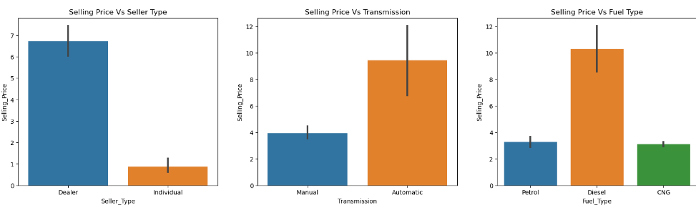
Analysis with Bar plot
Selling price vs seller type : Selling Price of cars seems to have higher prices when sold by Dealers when compared to Individuals.
Selling price vs transmission : It can be observed that Selling Price would be higher for cars that are Automatic.
Selling price vs fuel type : Selling Price of cars with Fuel Type of Diesel is higher than Petrol and CNG.

Slide 6
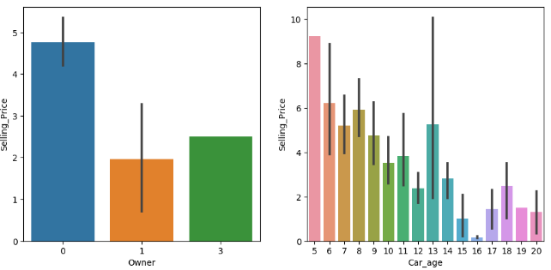
Selling price vs owner : Selling Price is high with less Owners used Cars.
Selling price vs car age : Selling Price of cars 2 years old would be high and gradually decreases with car of 17 years old.

Slide 7
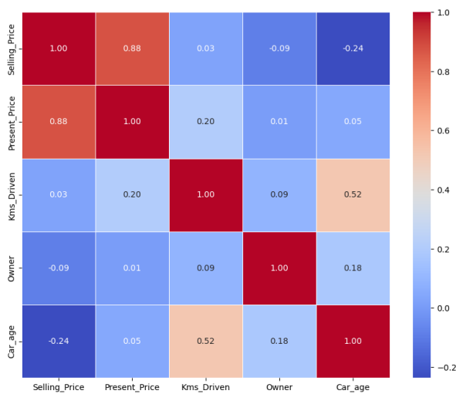
Analysis with Heatmap plot
Heatmap is used to visualize the correlations between different features in our dataset.
We can easily understand, how features are related to each other and can provide insights.
The diagonal line of the heatmap shows that, the each feature is perfectly correlated with itself (correlation coefficient = 1) where the selling_price is the target variable.

Slide 8
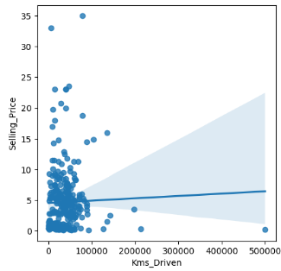
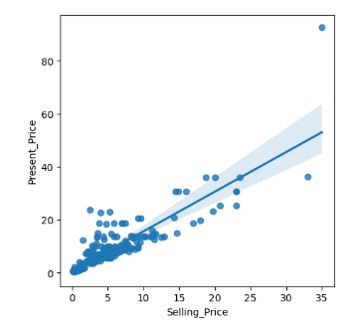
Analysis with any other plots
Regplot (regression plot)
creates a regression line between 2 parameters and helps to visualize their linear relationships.
Selling price vs kms driven : Lesser the Kms driven higher the Selling Price.
Selling price vs present price : selling price is lesser than the present price(ex show room price.

Slide 9
Model Building process
First split the data into training and testing i.e., x_train and x_test , y_train and y_test.
Then, import the model decision tree regressor, then fit the model into x_train and y_train.
Then I did a hyperparameter tuning to train a model for better performance.
I have fitted x_train and y_train into decision tree regressor to train the model.
Then I have predict , whether the model is giving accurate values or not.
As my dependent variable is continuous .so, I have imported r2_score to check the accuracy
Then I check score for x_train and y_train to get bias value. Similarly , I checked the score for x_test and y_test to get variance.

Slide 10
Results with algorithms
Algorithm | Accuracy | Bias | Variance
Decision Tree | 0.8572640488749044 | 0.8970544467935754 | 0.8572640488749044

Slide 11
Conclusion
In Decision Tree, We got accuracy 85% bias as 89% and variance as 85% is somewhat average accuracy but not upto the mark. So, I will conclude that for predicting a car price decision tree will give average accuracy. If we work with another machine learning algorithms we might get better results.

Slide 12
Thank You.

